Slide 1



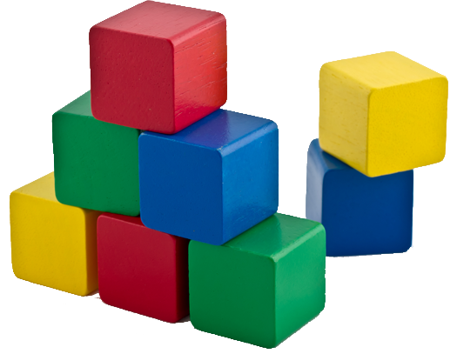

Objects and Classes
Using Objects and Classes Defining Simple Classes
Objects & Classes
O
O
SoftUni Team
O
O
Technical Trainers
P
P
Software University
http://softuni.bg

Slide 2
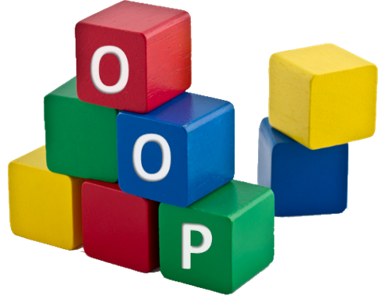



Table of Contents
Using Objects and Classes
Defining Simple Classes
Working with objects and comparison differences
Using API Classes
Random Numbers
Dates

Slide 3
Questions?
sli.do #python-fund

Slide 4
Objects and Classes
What is an Object? What is a Class? How to Use Them?

Slide 5
Classes
In programming, classes provide a structure for objects
Act as template for objects of the same type
Classes define:
Data (properties), e.g. day, month, year
Actions (behavior), e.g. add_days(count), subtract(date)
Class
Birthday
day
month
year
add_days(count)
subtract(date)

Slide 6
Objects
One class may have many instances (objects)
Sample class: Date
Sample objects: peterBirthday, mariaBirthday
object peterBirthday
Object name
Day = 27
Month = 11
Year = 1996
Object data

Slide 7
Classes vs. Objects
Objects
Classes
object peterBirthday
Object name
Class name
class DateTime
Day = 27
Month = 11
Year = 1996
Object data
Day: int
Month: int
Year: int
Class data (properties)
object mariaBirthday
Object name
AddDays(…)
Subtract(…)
Class actions (methods)
Day = 14
Month = 6
Year = 1995
Object data

Slide 8

Working with simple objects

Slide 9
Using the “is” operator
The operators is and is not test for object identity
“x is y” is true if x and y are the same object
They are compared by checking if they have the same id
firstList = list([5, 6, 10])
secondList = list([5, 6, 10])
print(firstList is secondList) # False
print(firstList is firstList) # True

Slide 10
Using the “==” operator
The operators == and != test for object equivalence
x == y is true if x and y have the same value
firstList = list([5, 6, 10])
secondList = list([5, 6, 10])
thirdList = list([5, 6, 11])
print(firstList == secondList) # True
print(secondList == thirdList) # False
print(firstList != thirdList) # True

Slide 11
Using the type(object) operator
The operators type returns the type of the passed object
Can later be combined with is to check an object’s type
a = 5
print(type(a)) # class <'int'>
print(type(a) is str) # False
print(type(a) is int) # True

Slide 12
Id() function
id() gives us a unique and constant identifier for each object in the lifecycle of the application
It is rarely used in production
Example:
First run
name = "Ivan"
age = 16
print(id(name))
print(id(age))
2343090569432
1886828064
Second run
2091808178392
1886828064

Slide 13
Defining Simple Classes

Slide 14
Defining Simple Classes with a “Constructor”
The __init__ method of each class is called while the object is being constructed
Its first argument should be self
self points to the current instance of the class
First argument of __init__ and all other class methods
class Point:
def __init__(self, x, y):
self.x = x
self.y = y

Slide 15
Instantiating Objects
Objects can be instantiated, using the class name + constructor:
Class data can be accessed using object_name.property:
class Point:
def __init__(self, x, y):
self.x = x
self.y = y
sample_point = Point(1, 2)
print(f'{sample_point.x}, {sample_point.y}')
# 1, 2

Slide 16
Problem: Distance between Points
Write a method to calculate the distance between two points p₁ {x₁, y₁} and p₂ {x₂, y₂}
Write a program to read two points (given as two integers) and print the Euclidean distance between them
def calc_distance(point1, point2):
3 4
6 8
5.000
3 4
5 4
2.000
8 2
5.5 2
2.500
Check your solution here: https://judge.softuni.bg/Contests/950

Slide 17
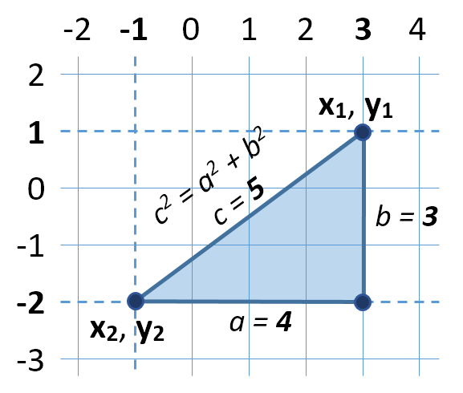

Solution: Distance between Points
Let's have two points p₁ {x₁, y₁} and p₂ {x₂, y₂}
Draw a right-angled triangle
Side a = |x₁ - x₂|
Side b = |y₁ - y₂|
Distance == side c (hypotenuse)
c² = a² + b² (Pythagorean theorem)
Distance = c = $\sqrt{a^{2}+b^{2}}$

Slide 18
Solution: Distance between Points
# Read both points separately
# Calculate the distance between them
distance = distance_between_points(p1, p2);
# Print the distance
print(f'{distance:.3f}')
def distance_between_points(p1, p2):
delta_x = p2.x - p1.x
delta_y = p2.y - p1.y
return math.sqrt(delta_x ** 2 + delta_y ** 2)
Check your solution here: https://judge.softuni.bg/Contests/950

Slide 19
Class Operations
Classes can define data (state) and operations (actions)
class Rectangle:
def __init__(self, width, height):
self.width = width
self.height = height
def calc_area(self):
return self.height * self.width
Classes may hold data (properties)
Classes may hold operations (methods)

Slide 20
Class Member Accessors
In Python, everything is public
Indicate “private” identifiers with 2 underscores in front of it:
class Rectangle:
def __init__(self, width, height):
self.__width = width
self.__height = height
def get_width(self):
return self.__width

Slide 21
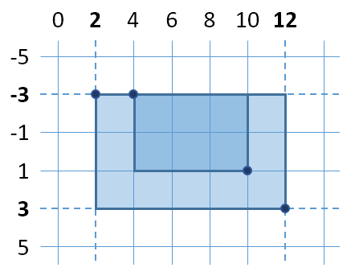
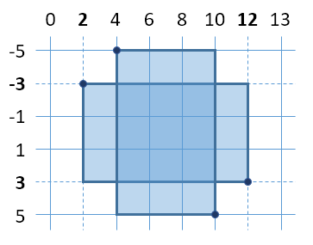
Problem: Rectangle Position
Write program to read two rectangles {left, top, width, height} and print whether the first is inside the second
4 -3 6 4
2 -3 10 6
2 -3 10 6
4 -5 6 10
Inside
Not inside
Check your solution here: https://judge.softuni.bg/Contests/950

Slide 22
Solution: Rectangle Position
class Rectangle:
def __init__(self, left, top, width, height):
self.left = left
self.top = top
self.width = width
self.height = height
self.right = self.left + self.width
self.bottom = self.top + self.height
def is_inside(self, other_rect):
# continued on next slide…

Slide 23
Solution: Rectangle Position (2)
def is_inside(self, other_rect):
if type(other_rect) is not type(self):
raise TypeError('other_rect is not a Rectangle!')
is_in_left = self.left >= other_rect.left
is_in_right = self.right <= other_rect.right
is_inside_horizontal = is_in_left and is_in_right
is_in_top = self.top >= other_rect.top
is_in_bottom = self.bottom <= other_rect.bottom
is_inside_vertical = is_in_top and is_in_bottom
return is_inside_horizontal and is_inside_vertical
Check your solution here: https://judge.softuni.bg/Contests/950

Slide 24
Solution: Rectangle Position (3)
def read_rectangle():
coords = [int(num) for num in input().split(' ')]
rect = Rectangle(*coords)
return rect
rect1 = read_rectangle()
rect2 = read_rectangle()
print('Inside' if rect1.is_inside(rect2) else 'Not inside')
Equivalent to coords[0], coords[1], coords[2], coords[3]
Check your solution here: https://judge.softuni.bg/Contests/950

Slide 25
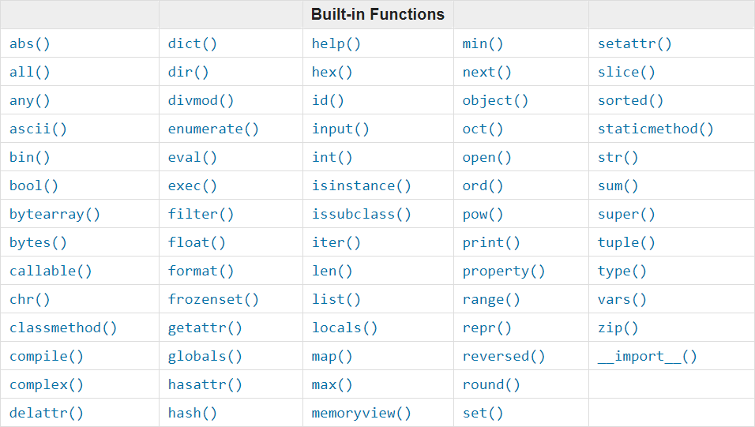
Using the Built-in API Classes
random, datetime, timedelta, etc.

Slide 26
API Classes: random
The random class has several useful methods:
Must be imported, using
randint(min, max): Returns a random integer in [min, max]
randrange(start, stop, [step]):
Returns a random integer in the given range
import random
random.randint(1, 10) # 2
random.randrange(1, 10) # 3

Slide 27
API Classes: random (2)
The random class has several useful methods:
choice(list): picks a random element from a list
seed(seed): Sets the pseudo random generator seed:
Random numbers will be the same each time
random.choice([10, 30, 'gosho', 510]) # 510
random.seed(500)
[random.randint(1, 10) for i in range(5)]
# [8, 9, 10, 8, 5]

Slide 28
API Classes: datetime
The datetime class has several useful classes:
Must be imported, using
date(year, month, day): Creates a date object
time(hours, minutes, seconds): Creates a time object
datetime(year, month, day, hours, minutes, seconds):
import datetime
python_3_release = datetime.date(2008, 12, 3)
high_noon = datetime.time(12, 0, 0)
python_3_noon = datetime.datetime(2008, 12, 3, 12, 0, 0)

Slide 29
API Classes: timedelta
timedelta represents a time span:
timedelta(year, month, day): Creates a timedelta object
Can be used with date/datetime for arithmetic operations:
judge_exam_time = datetime.timedelta(hours=6)
judge_exam_start_time = \
datetime(year=2018, month=3, day=11, hour=9)
judge_exam_duration = timedelta(hours=6)
judge_exam_end_time = \
judge_exam_start_time + judge_exam_duration
print(judge_exam_end_time.strftime('%d/%b/%y %H:%M'))
11/Mar/18 15:00

Slide 30
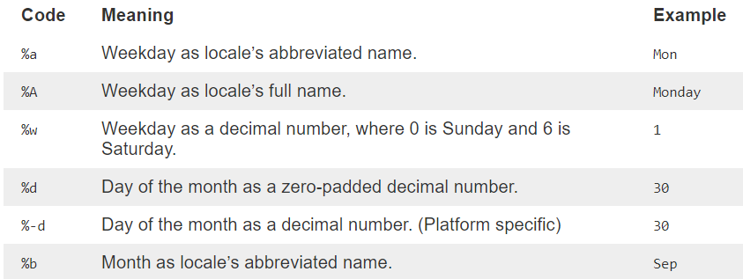
Formatting Strings with strftime()
Formatting date/time/datetime using strftime():
All formats at http://strftime.org/
python_3_release = datetime.date(2008, 12, 3)
print(python_3_release.strftime('%d %b %Y'))

Slide 31

Objects and Classes
Live Exercises in Class (Lab)

Slide 32
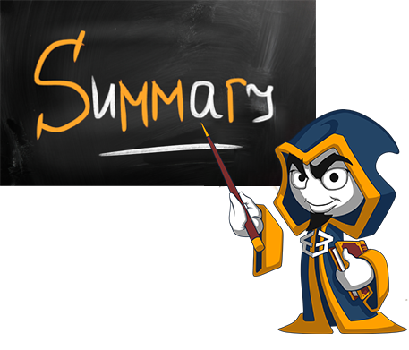
Summary
Objects hold a set of named values.
Classes define templates for object (data + actions)
Using __init__() for object construction
Using the built-in API classes

Slide 33






SoftUni Diamond Partners

Slide 34






SoftUni Diamond Partners

Slide 35







Lists and Dictionaries
https://softuni.bg/courses/

Slide 36

License
This course (slides, examples, demos, videos, homework, etc.) is licensed under the "Creative Commons Attribution-NonCommercial-ShareAlike 4.0 International" license
Attribution: this work may contain portions from
"Fundamentals of Computer Programming with C#" book by Svetlin Nakov & Co. under CC-BY-SA license
Icons from http://www.flaticon.com/ (credits: Freepik, Madebyoliver)
36
Notes:
© Software University Foundation – http://softuni.org
This work is licensed under the Creative Commons Attribution-NonCommercial-ShareAlike license.
36

Slide 37




Trainings @ Software University (SoftUni)
Software University – High-Quality Education, Profession and Job for Software Developers
softuni.bg
Software University Foundation
http://softuni.foundation/
Software University @ Facebook
facebook.com/SoftwareUniversity
Software University Forums
forum.softuni.bg
Notes:
© Software University Foundation – http://softuni.org
This work is licensed under the Creative Commons Attribution-NonCommercial-ShareAlike license.
37

